Slide 1
Templates and resources
03-60-270-91 Advanced website design
Abedalrhman Alkhateeb

Slide 2

Image slider
An example of using buttons to indicate how many slides there are in the slideshow, and which slide the user is currently viewing.
Source: https://www.w3schools.com/w3css/tryit.asp?filename=tryw3css_slideshow_dots2

Slide 3

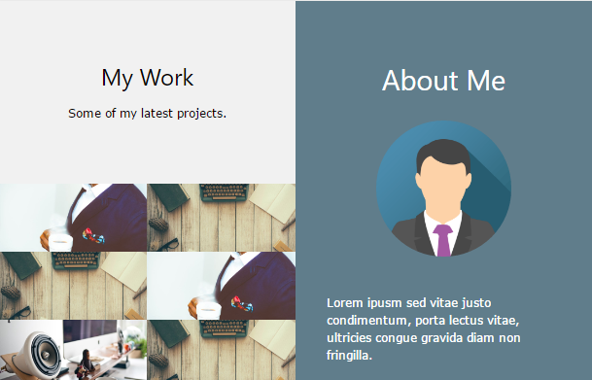
Responsive grid
Source:
https://www.w3schools.com/w3css/tryit.asp?filename=tryw3css_trends_50

Slide 4
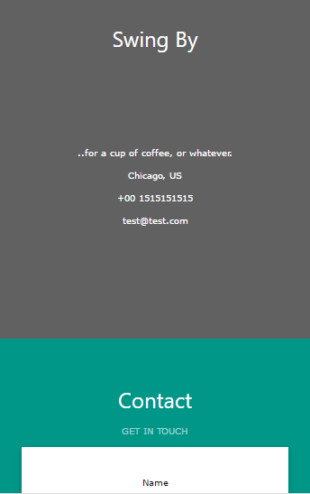
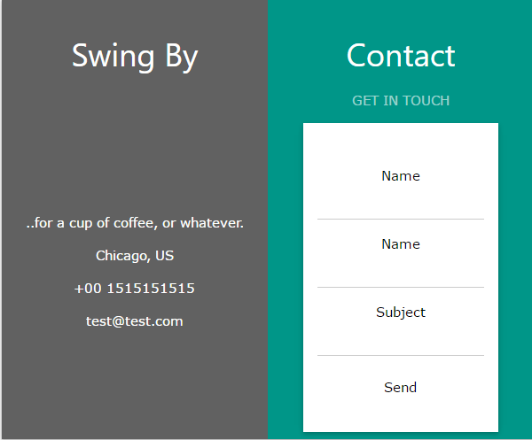
Responsive grid

Slide 5
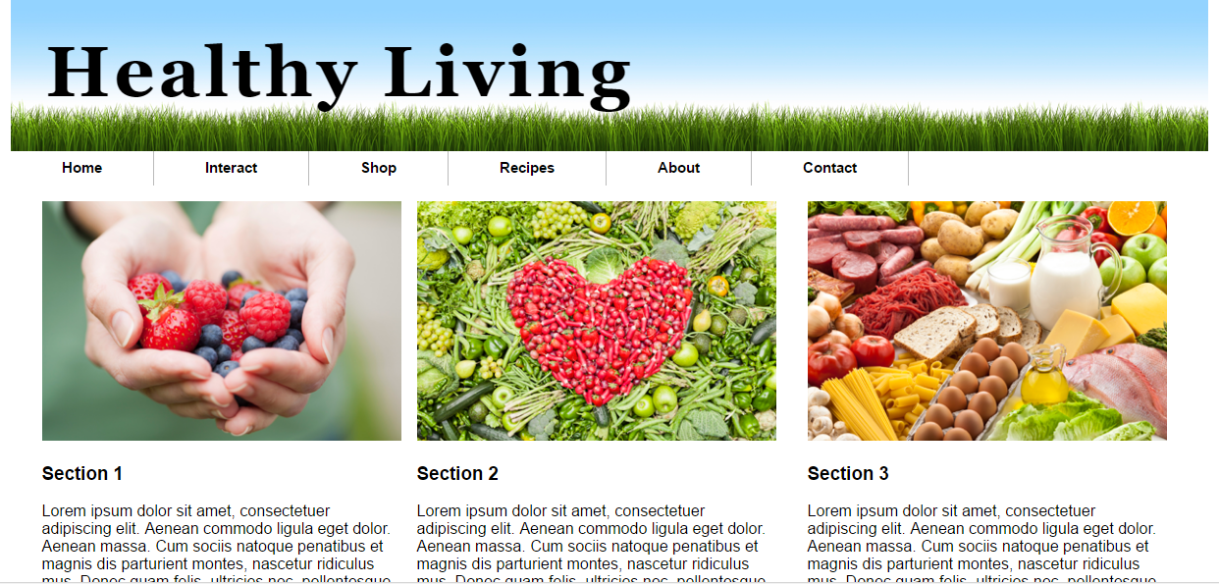
Responsive grid – with menu

Slide 6
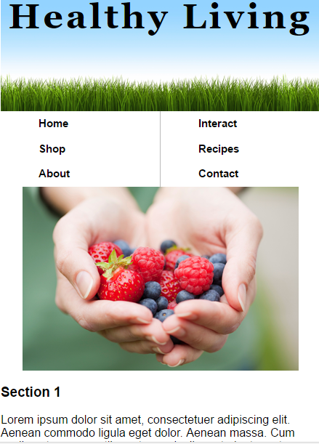
Responsive grid – with menu
Source code:
Blackboard →270→ Resources →Advanced responsive web page - from ch12
Try it:
http://alkhate.myweb.cs.uwindsor.ca/advanced_responsive/ch12activity2_solution.html

Slide 7

Black & white photo template
Demo : https://www.w3schools.com/w3css/tryw3css_templates_photo2.htm
Try it: https://www.w3schools.com/w3css/tryit.asp?filename=tryw3css_templates_photo2&stacked=h

Slide 8
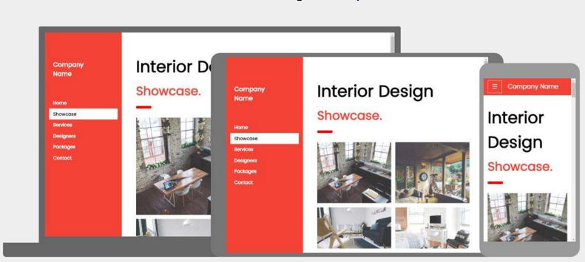
Interior Design template
Demo : https://www.w3schools.com/w3css/tryw3css_templates_interior_design.htm
Try it: https://www.w3schools.com/w3css/tryit.asp?filename=tryw3css_templates_interior_design&stacked=h

Slide 9
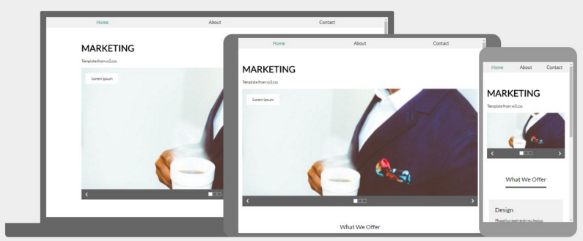
Marketing template
Demo : https://www.w3schools.com/w3css/tryw3css_templates_marketing.htm
Try it: https://www.w3schools.com/w3css/tryit.asp?filename=tryw3css_templates_marketing&stacked=h

Slide 10
More Templates
W3.CSS Templates
https://www.w3schools.com/w3css/w3css_templates.asp
Bootstap
http://getbootstrap.com/

Slide 11
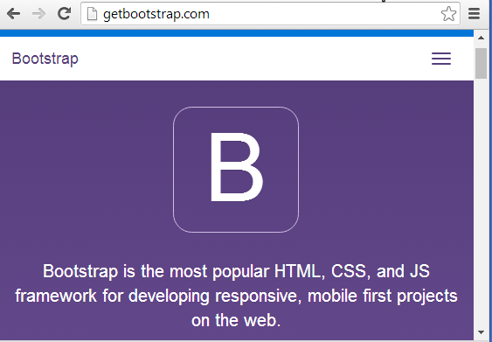
Bootstrap
Bootstrap is an HTML5 & CSS3 framework
Which is designed to help you kickstart the development of websites and apps.
You may customize your own template.

Slide 12
References
W3schools.com
https://www.w3schools.com/w3css/w3css_templates.asp
http://getbootstrap.com/
J. Sklar, "Principles of Web Design 6th Edition by Joel Sklar - Ch. 12."

